Slide 1


Spring 2021
SKKU Biostats and Big data
CHOONG-WAN WOO | COCOAN lab | http://cocoanlab.github.io

Slide 2
Lecture 01
Instead,
Please complete this now:
https://forms.gle/u2MFKnRdcSar45QT6
If your second question is no, please join the slack now:
https://join.slack.com/t/wanistats1spring2021/shared_invite/zt-lit882v9-6YJ3XUBvt9IlPK84tNNRpg
CHOONG-WAN WOO | COCOAN lab | http://cocoanlab.github.io

Slide 3
GBME Probability and Statistics
Lecture 03
Lecture 03
Data visualization
CHOONG-WAN WOO | COCOAN lab | http://cocoanlab.github.io

Slide 4
Lecture 03
Quiz!
https://forms.gle/URCyubhRC6gK2M3P9
CHOONG-WAN WOO | COCOAN lab | http://cocoanlab.github.io

Slide 5

Lecture 03
Three Rules of Data Analysis
Make a picture
Make a picture
Make a picture
To think, show, and tell…
And to make it cool!
E.g., https://d3js.org
CHOONG-WAN WOO | COCOAN lab | http://cocoanlab.github.io

Slide 6
Lecture 03
Why visualization matters
We’re lazy and don’t like to read
Some information isn’t easy to describe verbally
Statistical summaries can be misleading
Aesthetically-pleasing visuals are engaging
Anscombe's quartet:
https://en.wikipedia.org/wiki/Anscombe%27s_quartet
Slide credit: Tal Yarkoni
CHOONG-WAN WOO | COCOAN lab | http://cocoanlab.github.io

Slide 7
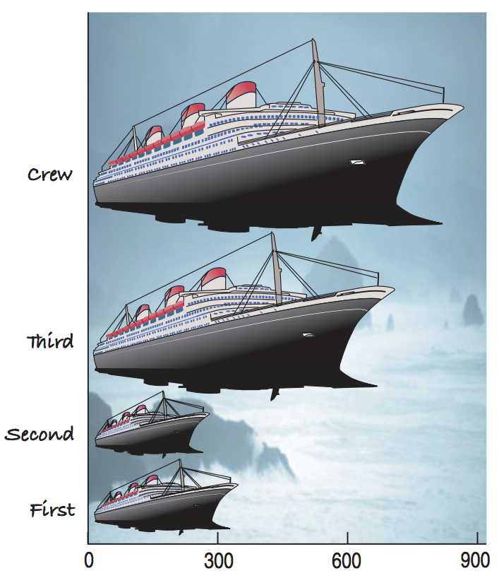
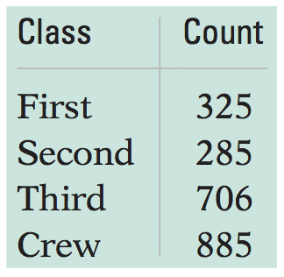
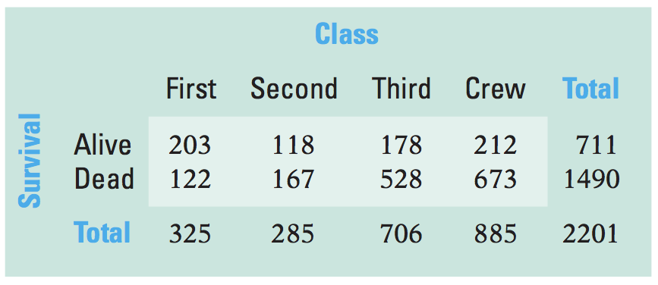
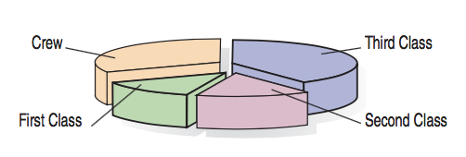
Lecture 03
Textbook’s example data
Frequency/contingency table of “ticket class” and “Survival” for the Titanic passengers
Frequency table
Contingency table
What’s wrong with this plot?
“Area principle”: the area occupied by a part of the graph should correspond to the magnitude of the value it represents.
CHOONG-WAN WOO | COCOAN lab | http://cocoanlab.github.io

Slide 8
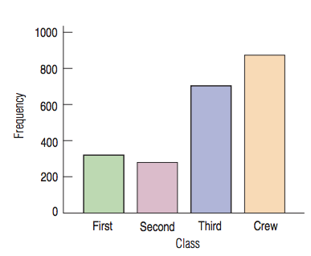
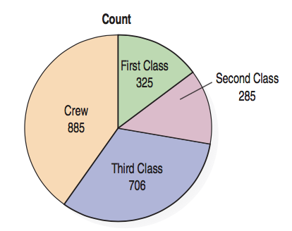
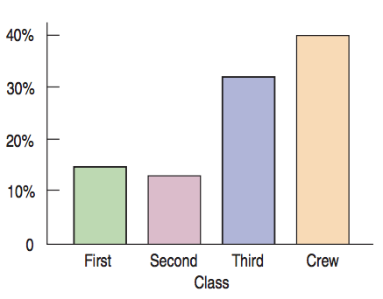
Lecture 03
Bar Charts, Pie Charts
Relative frequency bar chart
CHOONG-WAN WOO | COCOAN lab | http://cocoanlab.github.io

Slide 9
Lecture 03
Marginal distribution, conditional distribution
Marginal distribution of “Survival”
Contingency table
Conditional distribution
(satisfy a condition on another variable)
Marginal distribution of “Class”
CHOONG-WAN WOO | COCOAN lab | http://cocoanlab.github.io

Slide 10
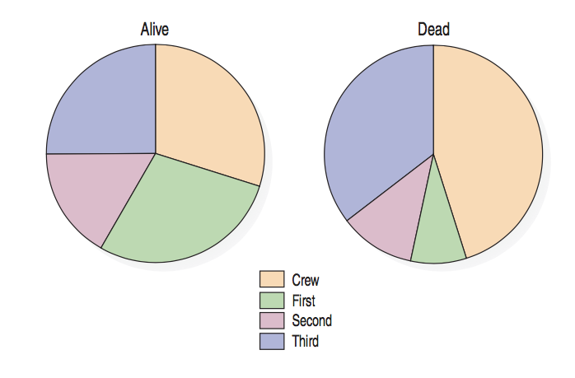
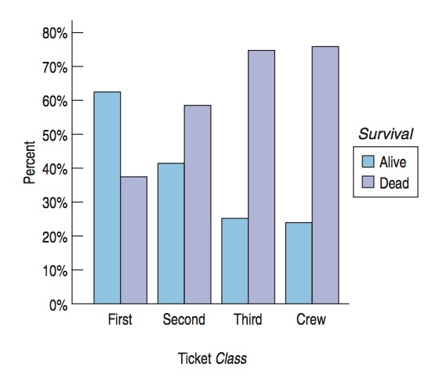
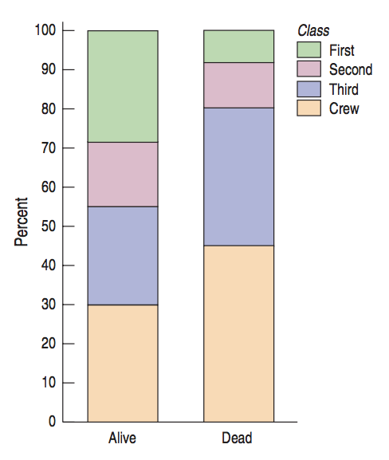
Lecture 03
Charts for conditional distribution
The variables are independent: “when the distribution of one variable tells us nothing about the distribution of the other variable”
CHOONG-WAN WOO | COCOAN lab | http://cocoanlab.github.io

Slide 11
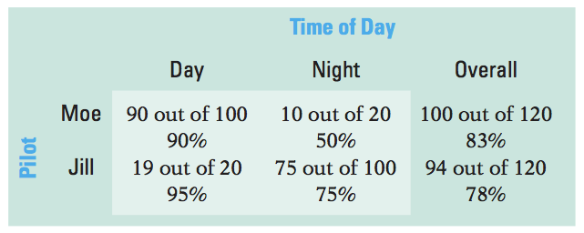
Lecture 03
Simpson’s Paradox
Two pilots, Moe and Jill
Who is the better pilot?
Proportion of on-time flights
CHOONG-WAN WOO | COCOAN lab | http://cocoanlab.github.io

Slide 12
Lecture 03
Simpson’s Paradox
Two pilots, Moe and Jill
Who is the better pilot?
Now who is the better pilot?
Don’t average over things unfairly
Different numbers in different categories for Day and Night
Unfair to average across categories
Proportion of on-time flights
CHOONG-WAN WOO | COCOAN lab | http://cocoanlab.github.io

Slide 13
Lecture 03
Quiz!
https://forms.gle/YW1oFmUBvMNQySiN9
CHOONG-WAN WOO | COCOAN lab | http://cocoanlab.github.io

Slide 14
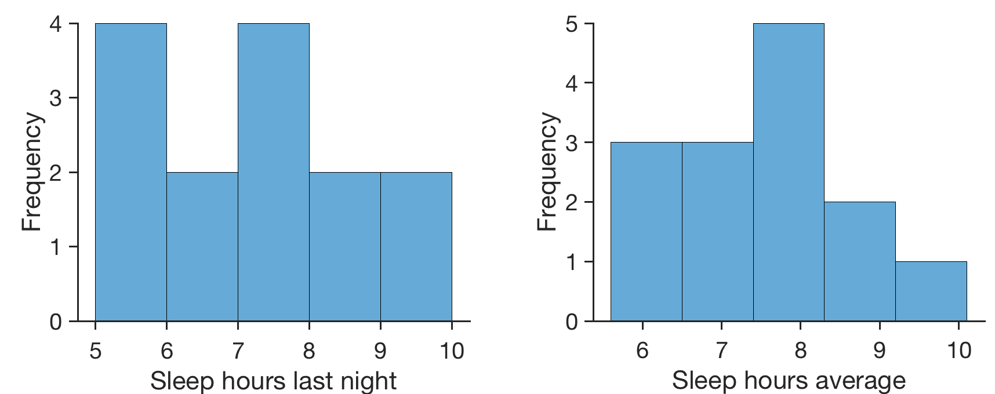
Lecture 03
Histograms for quantitative data
 | sleep_hours_last_night | sleep_hours_average
Indiv 1 | 7 | 6
Indiv 2 | 5.5 | 6.5
Indiv 3 | 9 | 7
Indiv 4 | 5 | 7
Indiv 5 | 5 | 6
Indiv 6 | 7 | 8
Indiv 7 | 8 | 7
Indiv 8 | 7 | 8
Indiv 9 | 8 | 10
Indiv 10 | 10 | 9
Indiv 11 | 6 | 7.5
Indiv 12 | 7 | 9
Indiv 13 | 6 | 8
Indiv 14 | 5 | 8
CHOONG-WAN WOO | COCOAN lab | http://cocoanlab.github.io

Slide 15
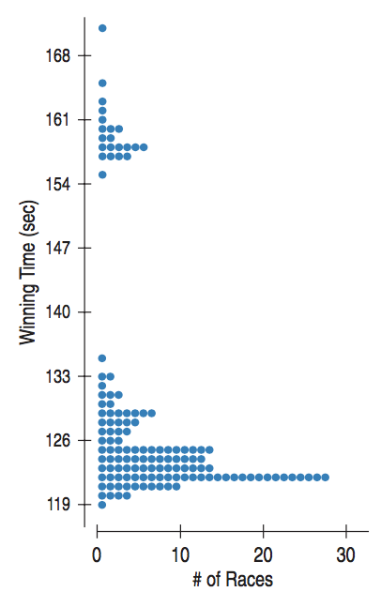
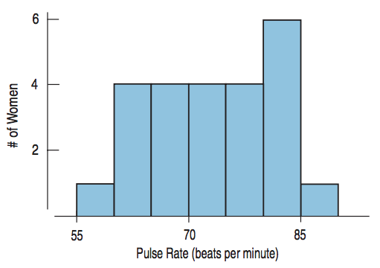
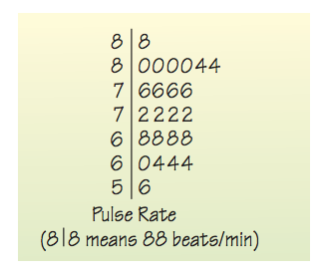
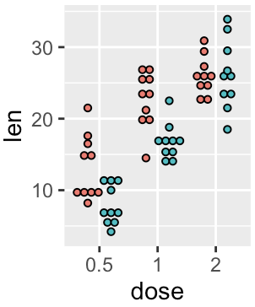
Lecture 03
Stem/leaf, dot plot
Histogram
Stem-and-leaf display
Dotplots
CHOONG-WAN WOO | COCOAN lab | http://cocoanlab.github.io

Slide 16
Lecture 03
Shape
Modes?
http://researchhubs.com/post/ai/data-analysis-and-statistical-inference/visualizing-numerical-data.html
CHOONG-WAN WOO | COCOAN lab | http://cocoanlab.github.io

Slide 17
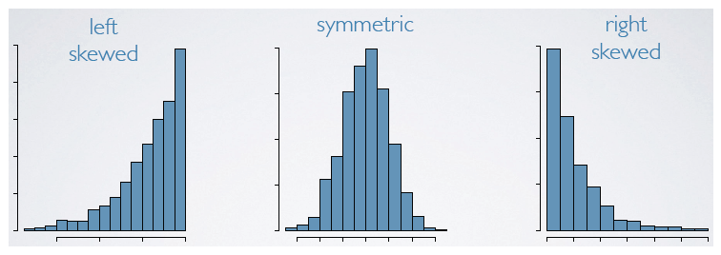
Lecture 03
Shape
Modes?
Symmetric?
http://researchhubs.com/post/ai/data-analysis-and-statistical-inference/visualizing-numerical-data.html
CHOONG-WAN WOO | COCOAN lab | http://cocoanlab.github.io

Slide 18
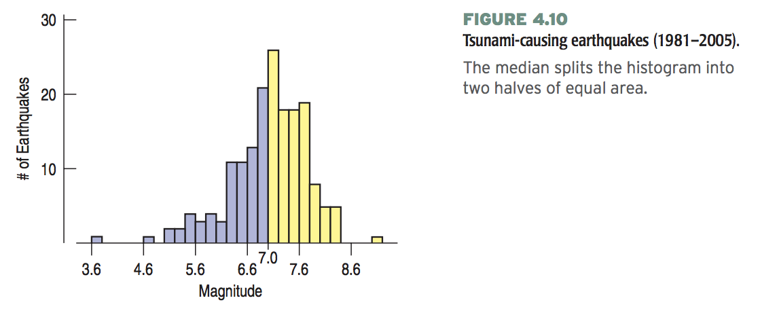
Lecture 03
Center
Median
176 earthquakes
Median: (176+1)/2 = 88.5th value in the sorted data
“.5” = average of the two values (88th and 89th)
If there was 221 earthquakes
Median: (221+1)/2 = 111th value in the sorted data
CHOONG-WAN WOO | COCOAN lab | http://cocoanlab.github.io

Slide 19
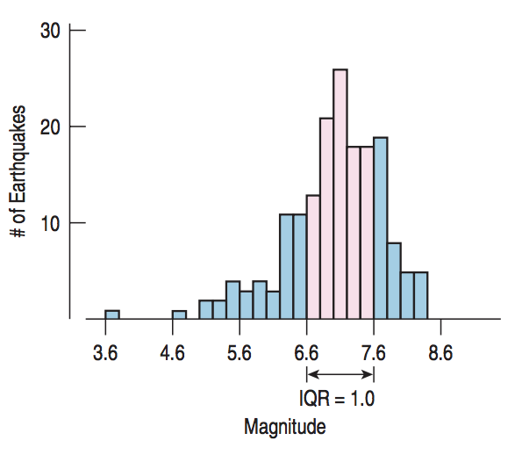
Lecture 03
Spread
Range
Range = max – min
Interquartile range
Interquartile range (IQR) = upper quartile – lower quartile
50%
CHOONG-WAN WOO | COCOAN lab | http://cocoanlab.github.io

Slide 20
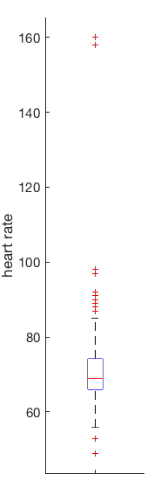
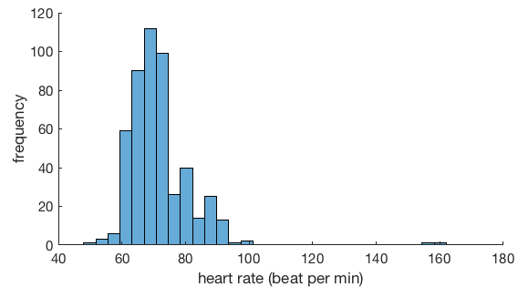
Lecture 03
Boxplots and 5-Number Summaries
far outliers
My heart rate data for a week (7/10-7/14)
Max | 160
Q3 | 74
Median | 69
Q1 | 66
Min | 49
outliers
Q3 + 1.5 IQR
Q3
Median
Q1
Q1 - 1.5 IQR
CHOONG-WAN WOO | COCOAN lab | http://cocoanlab.github.io

Slide 21
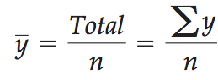
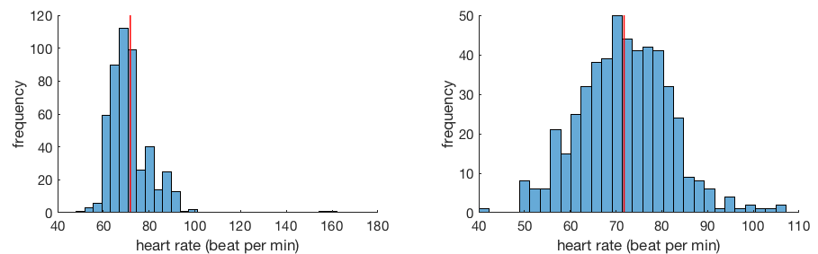
Lecture 03
Center of Symmetric Distribution: Mean
If the histogram is symmetric and there are no outliers, the mean will be preferable.
However, if the histogram is skewed or has outliers, the median might be better.
CHOONG-WAN WOO | COCOAN lab | http://cocoanlab.github.io

Slide 22
Lecture 03
Quiz!
https://forms.gle/GSGcaeAXt6d8vknz9
CHOONG-WAN WOO | COCOAN lab | http://cocoanlab.github.io

Slide 23
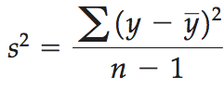
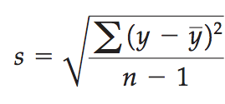
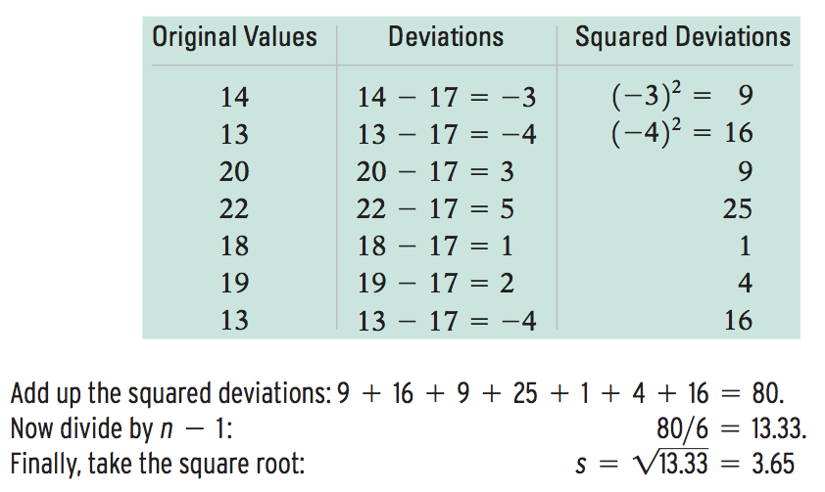
Lecture 03
Spread of Symmetric Distribution: Standard Deviation
Variance
Standard Deviation
Mean = 17
CHOONG-WAN WOO | COCOAN lab | http://cocoanlab.github.io

Slide 24
Lecture 03
Quiz!
https://forms.gle/uSY8Cj5AzsxjVTTw6
CHOONG-WAN WOO | COCOAN lab | http://cocoanlab.github.io

Slide 25
Lecture 03
Key Points
Chapter 3: Displaying categorical data
Bar chart for categorical data
Pie chart for proportions of whole
Faithful reporting and the area principle
Contingency tables
Simpson’s paradox
Chapter 4: Displaying quantitative data
Histograms, Stem-leaf, dot plots
Shape (mode, symmetrical)
Center (median, mean)
Spread (range, IQR, variance, standard deviation)
Box plots
CHOONG-WAN WOO | COCOAN lab | http://cocoanlab.github.io

